Slide 1
Master Thesis
cand. el. Dinggen Dai

Slide 2
Structure
1 Motivation and Objective
2 Fundamental
3 Concept
4 Evaluation and Analyse
5 Conclusion and Outlook

Slide 3
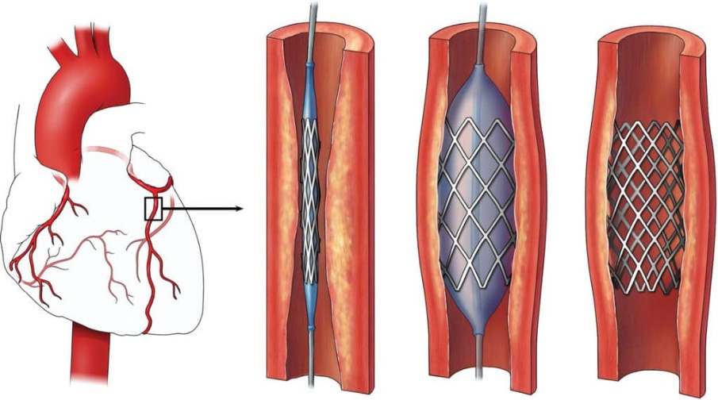
1.1 Motivation: background
Stent: an important life-saving device
treat cardiovascular diseases [1-2]
Stent manufacture:
quality inspection: manual vs. Automatic
high precision
faster
lower cost
Automatic inspect system is desirable!
Stent implantation process [2]

Slide 4
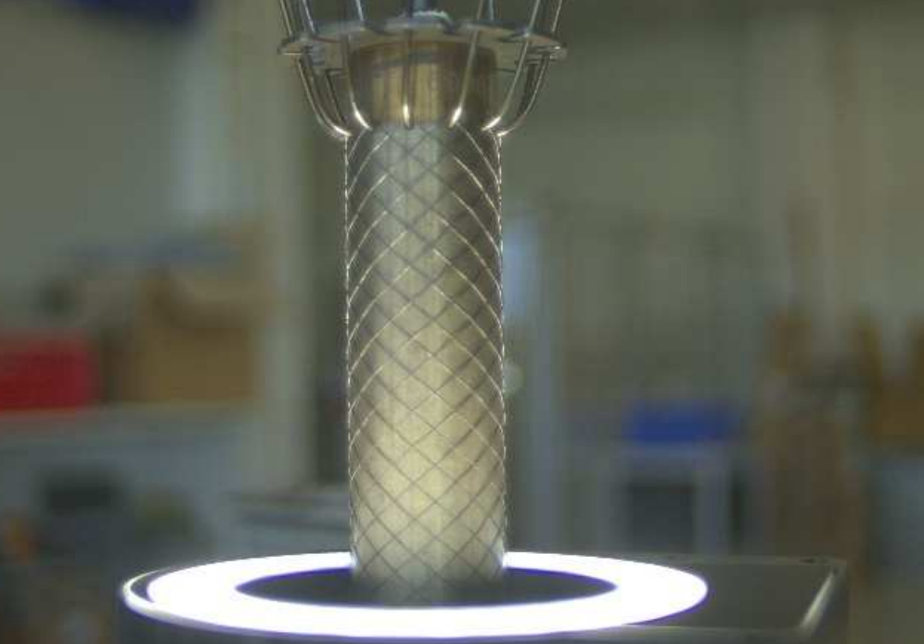
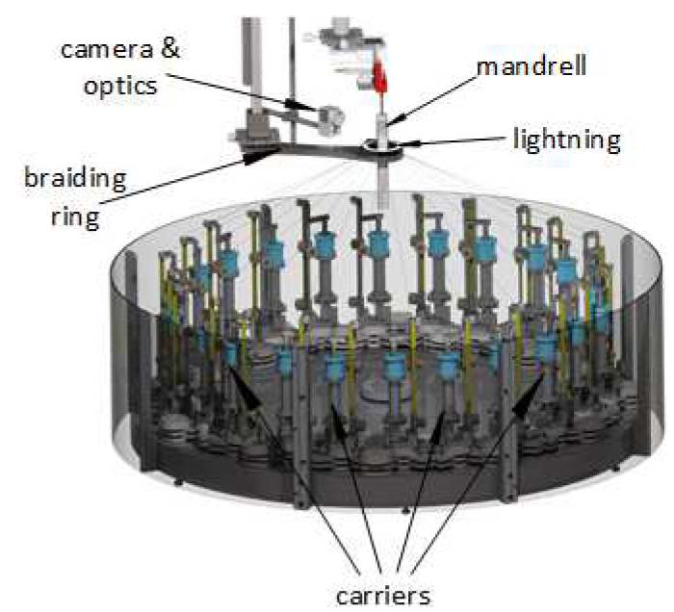

1.1 Motivation: background (Stent4Tomorrow)
visual inspection related parts [3]
manufacturing system [3]
focus on the stent

Slide 5
1.2 Objective: borders extraction
Issue 1: the size of the pitch
how to “enlarge”?
Issue 2: the background
single image size (3 ~ 8 MB)
how to remove?
less calculation
Solution: borders extraction!
Extra: build the mapping relations between image (pixel) and human perception (mm)
1. the diameter of the mandrel (in mm)
2. the distance of the borders (in pixel)
focus on the stent

Slide 6
Structure
1 Motivation and Objective
2 Fundamental
3 Concept
4 Evaluation and Analyse
5 Conclusion and Outlook

Slide 7
2 Fundamental: research domain
Why choose LSD (line segment detection)？
straightforward
Part I: classic image process
4 approaches
Part II: deep learning based
2 approaches
Segmentation
Rome
……
LSD
……
Bounding box based object detection

Slide 8
2.1.1 Classic: bottom-up
LSD: line segment detector (2010) [4]
now: still typical
EDLines (2011) [5]
10 times faster than LSD

Slide 9
2.1.1 Classic: bottom-up
CannyPF (2015) [6]
based on canny filter
parameter free
(没有示意图)

Slide 10
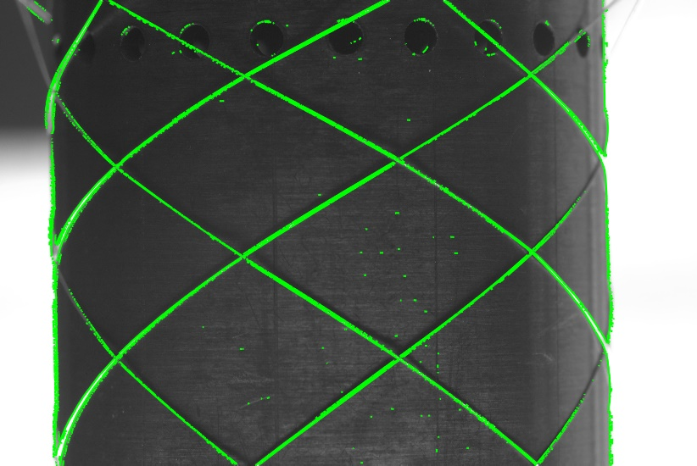
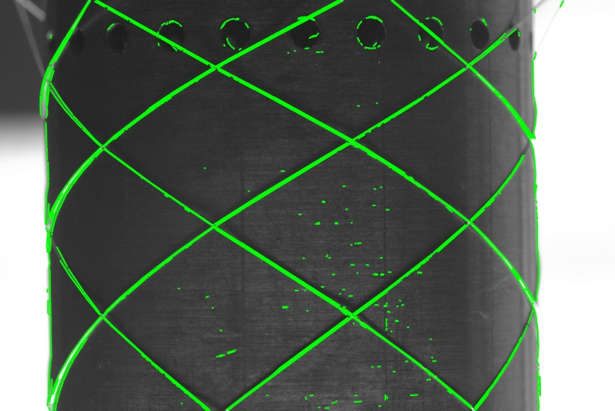
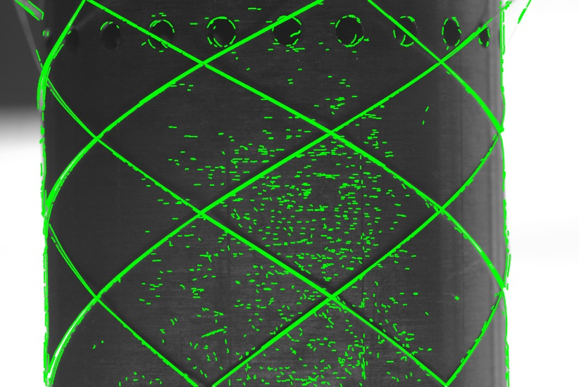
2.1.1 Classic: bottom-up
LSD
EDLines
CannyPF

Slide 11
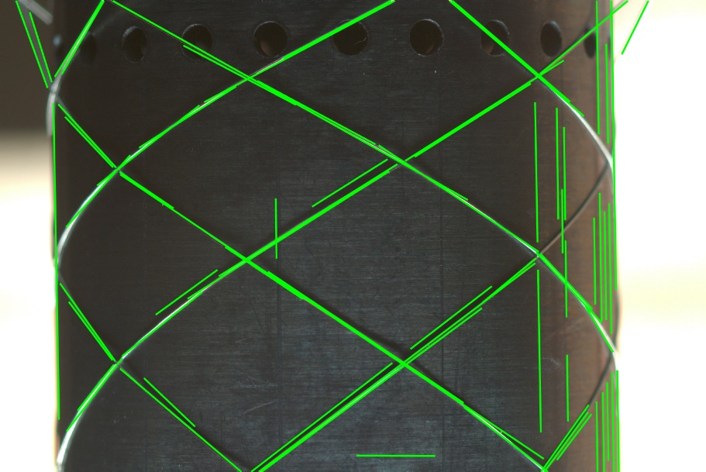
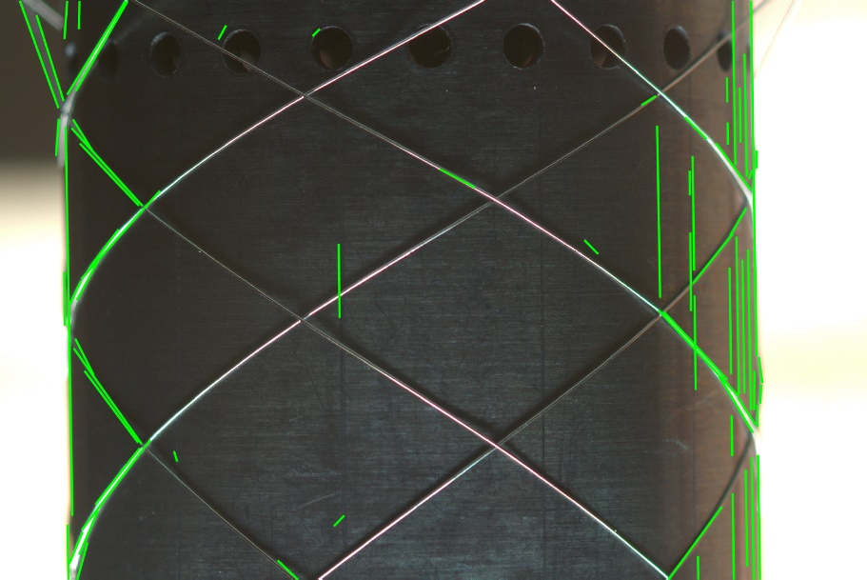
2.1.2 Classic: top-down
MCMLSD (CVPR 2017) [7]
Step1: HT
Step2: MCM

Slide 12
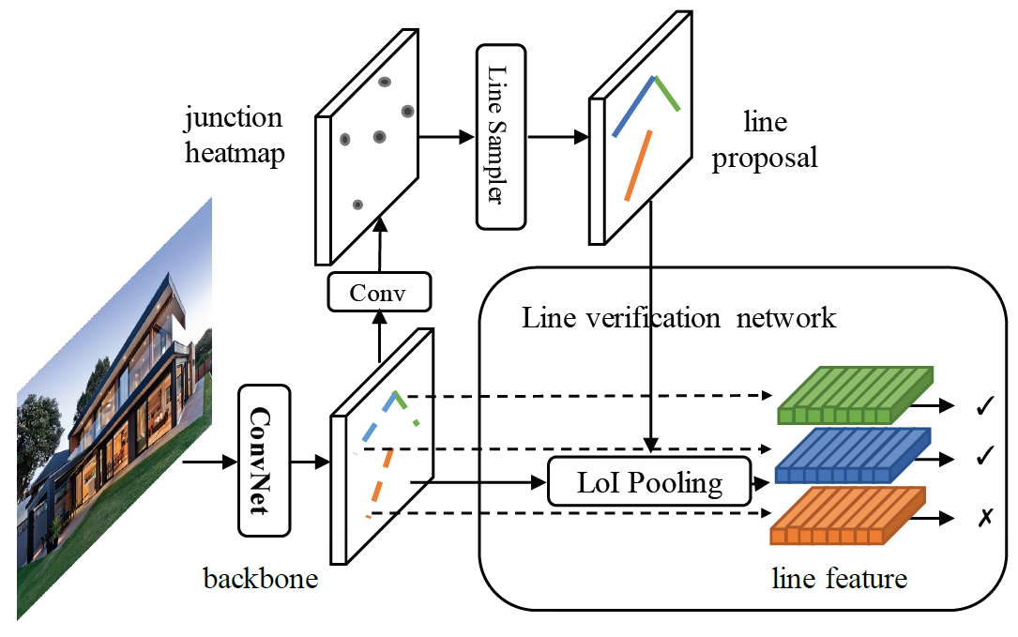
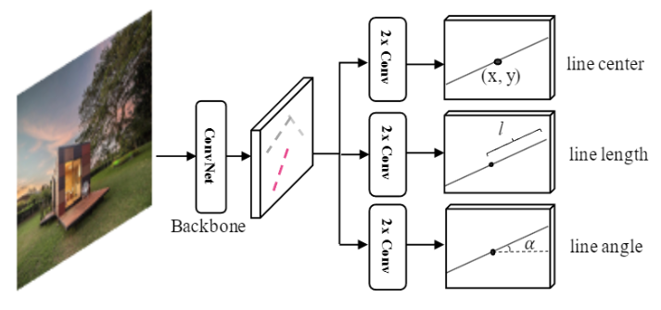
2.2 Deep learning (HT-LCNN 标注输出)
HT-LCNN (ECCV 2020) [8]
based on LCNN (ICCV 2019)
add a trainable Hough transfrom block into a deep network
F-Clip [9]
SOTA of line detectors (2021)
one stage: much more faster
the representation of a line
An overview of LCNN architecture
An overview of F-Clip architecture

Slide 13
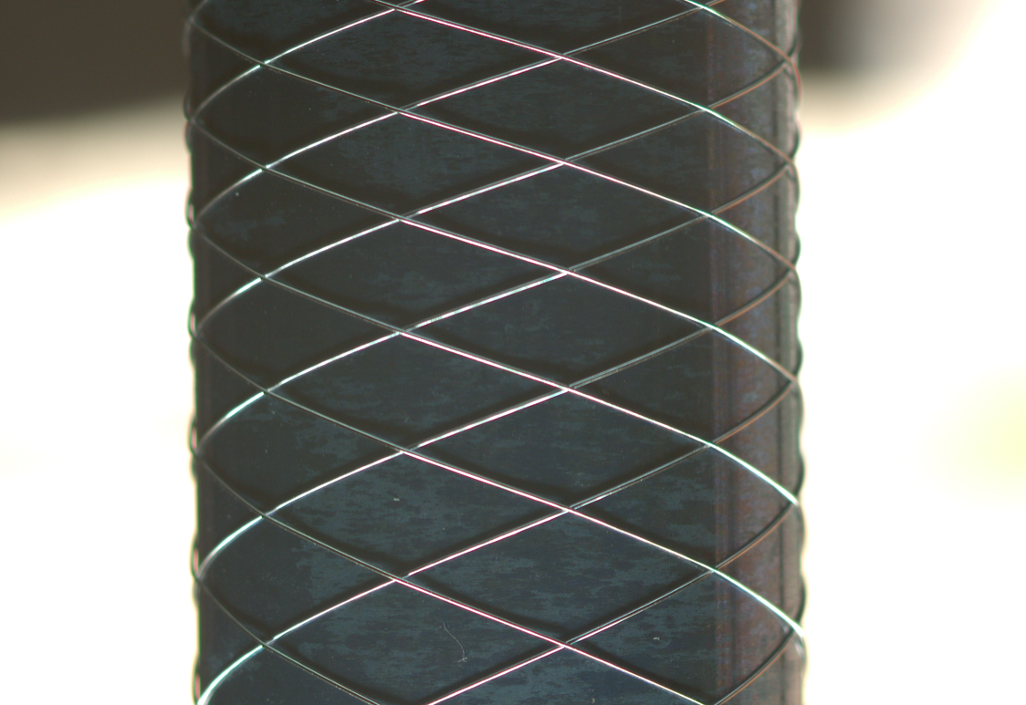
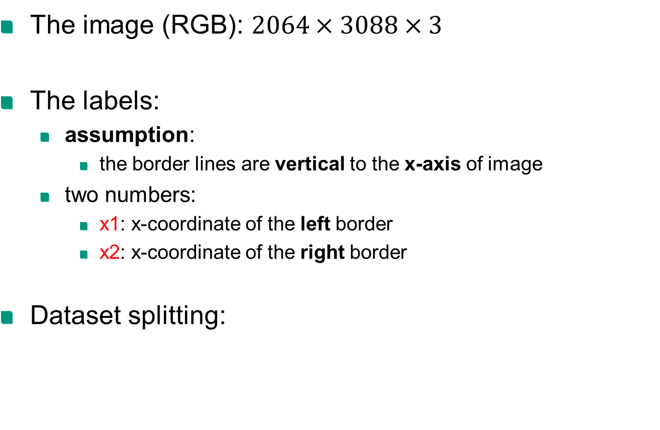
2.3 Input: Dataset
x1
x
x2
The image (RGB): $2064×3088×3$
The labels:
assumption:
the border lines are vertical to the x-axis of image
two numbers:
x1: x-coordinate of the left border
x2: x-coordinate of the right border
Dataset splitting:
y
 | Training | Validation | Test
Total | 4881 | 1085 | 1508

Slide 14
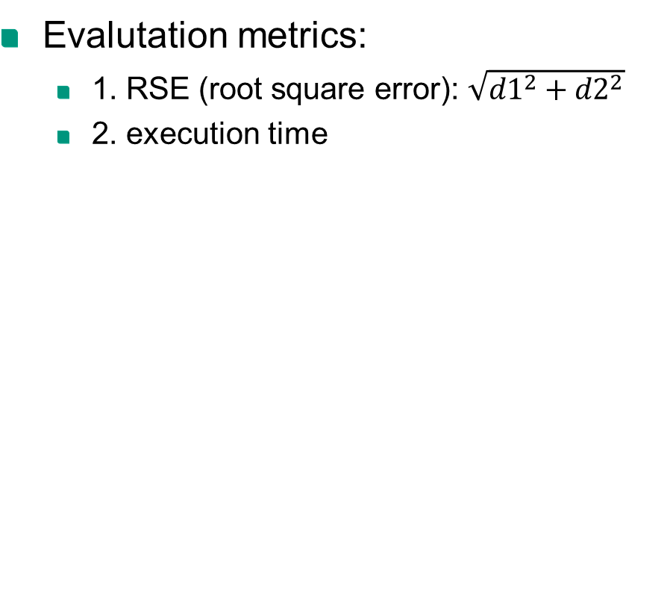
2.4 Output: two border lines
Evalutation metrics:
1. RSE (root square error): $\sqrt{{d1}^{2}+{d2}^{2}}$
2. execution time
x1
x
x2
y
d1
d2

Slide 15
Structure
1 Motivation and Objective
2 Fundamental
3 Concept
4 Evaluation and Analyse
5 Conclusion and Outlook

Slide 16
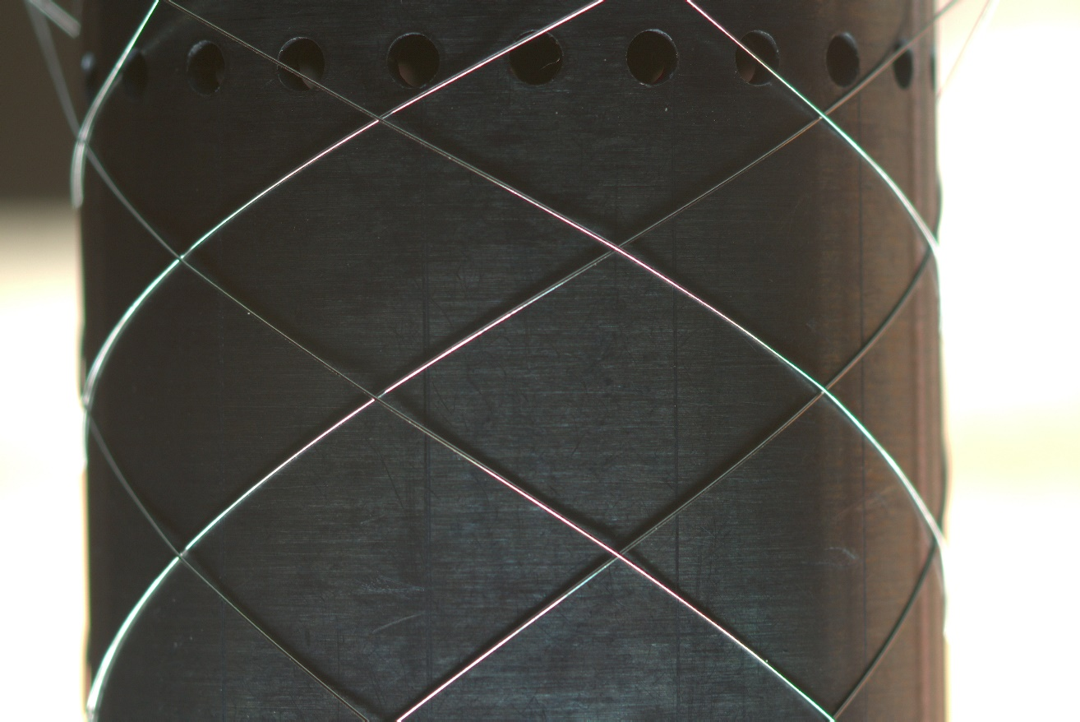
3.1 Concept: classic approaches
Start
Load RGB image
Edge detector
Valid edge extractor
Border line generator
Get border lines
End

Slide 17

3.1 Concept: classic approaches
Start
Load RGB image
Edge detector
Valid edge extractor
Border line generator
Get border lines
End

Slide 18
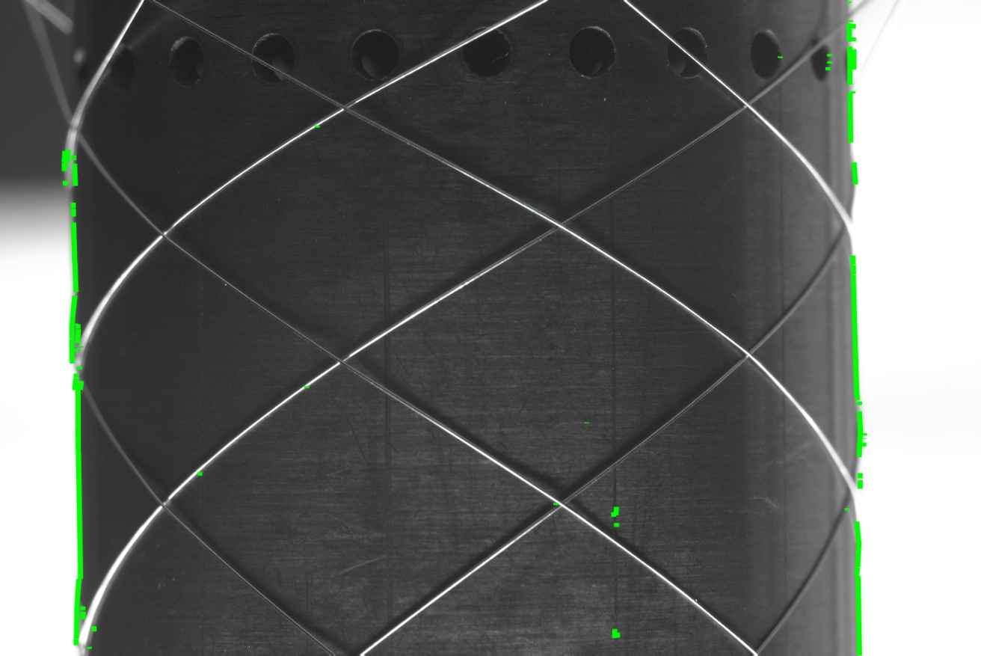
3.1 Concept: classic approaches
Start
Load RGB image
Edge detector
Valid edge extractor
Border line generator
Get border lines
angle filter + moving window
End

Slide 19
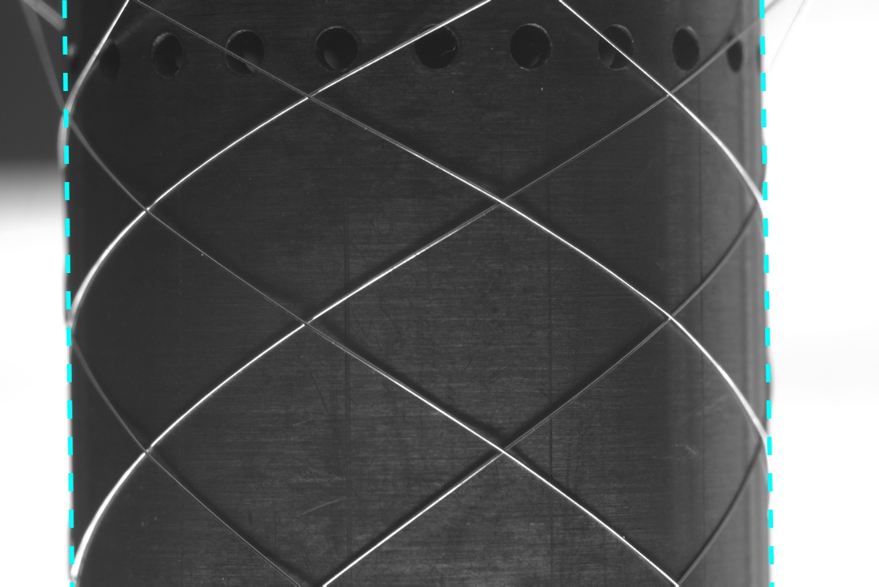
3.1 Concept: classic approaches
Start
Load RGB image
Edge detector
Valid edge extractor
Border line generator
Get border lines
least square method
End

Slide 20
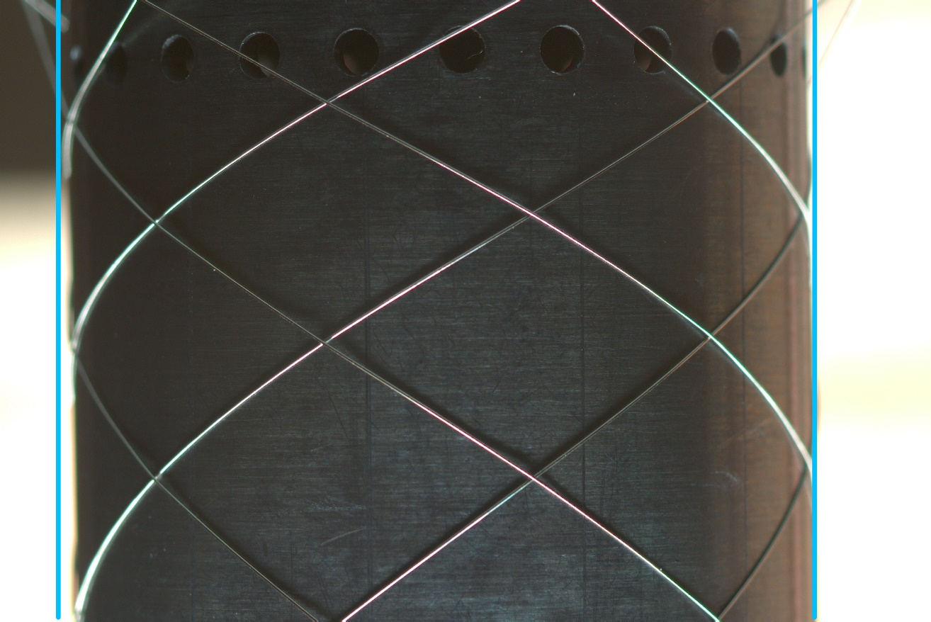
3.2 Concept: deep learning approaches
Start
Load RGB image
Backbone
Model:
Head: multitask learner
Head: line prediction
Get border lines
End

Slide 21
Structure
1 Motivation and Objective
2 Fundamental
3 Concept
4 Evaluation and Analyse
5 Conclusion and Outlook

Slide 22
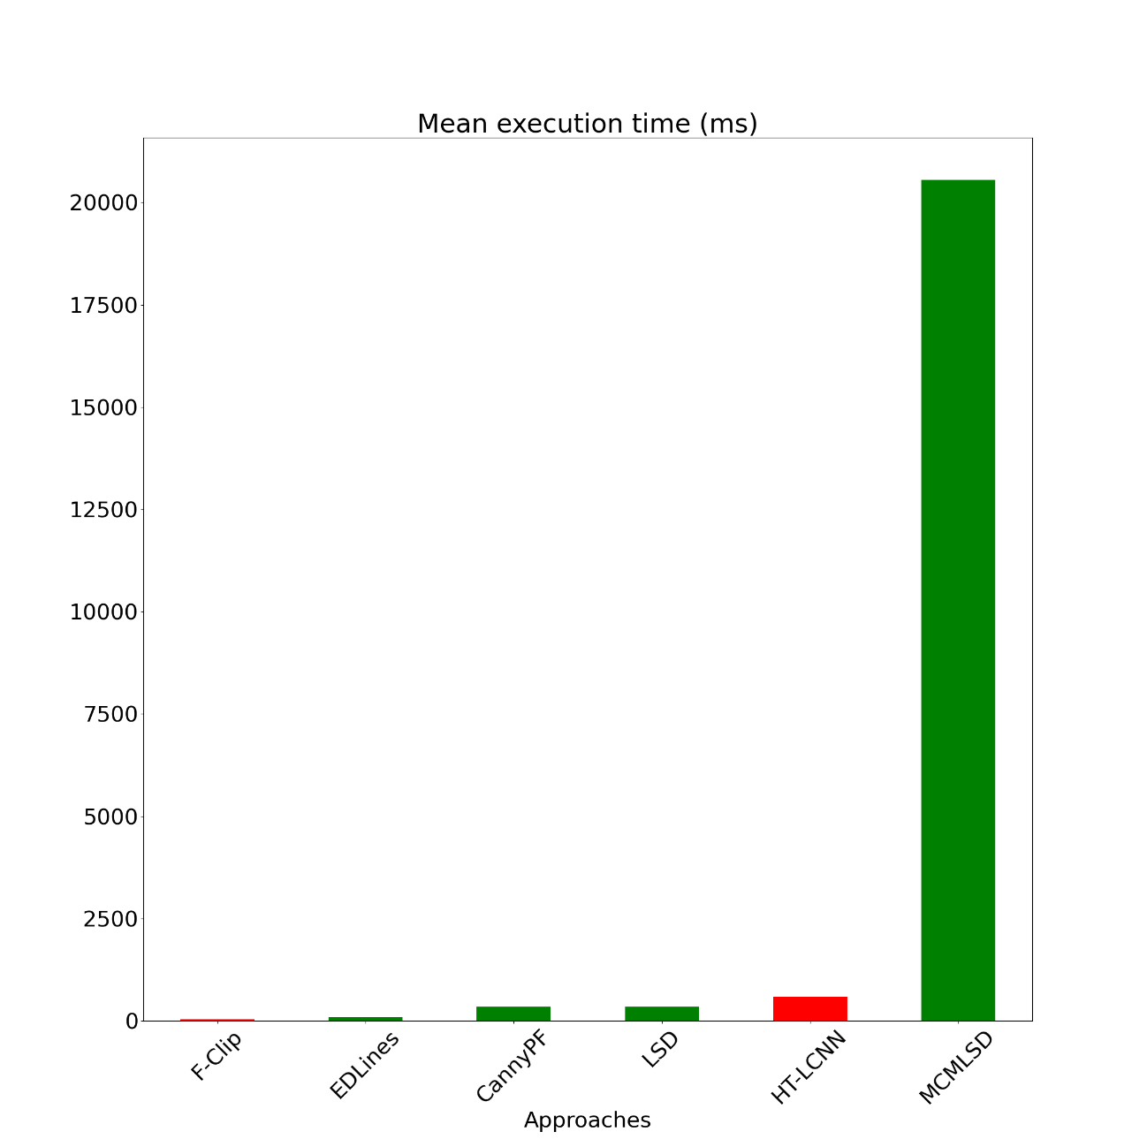
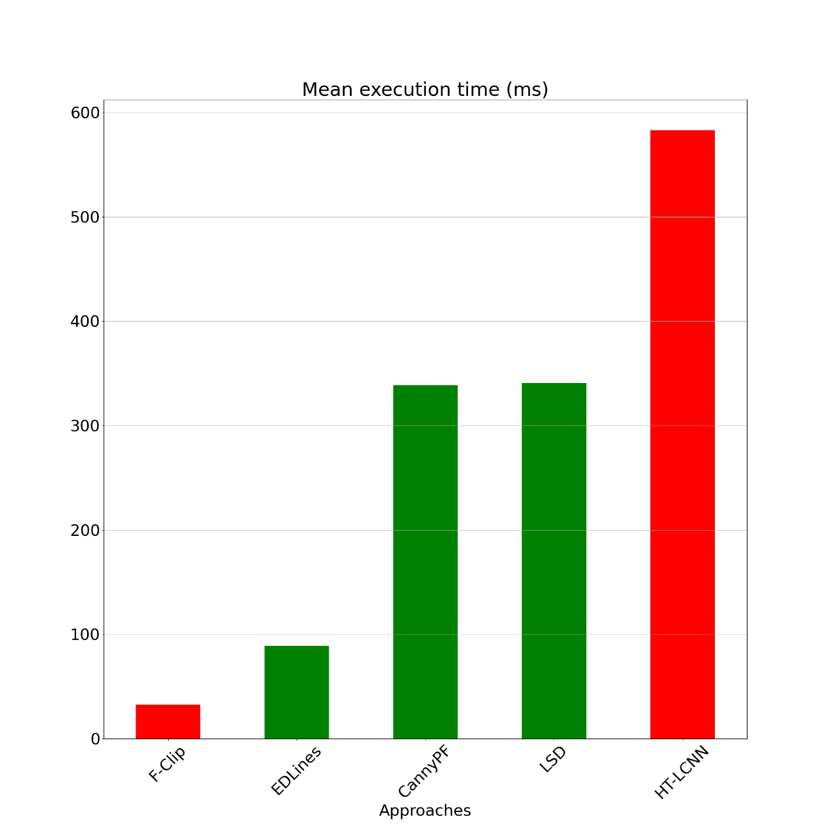
4.1 Evaluation: mean execution time

Slide 23
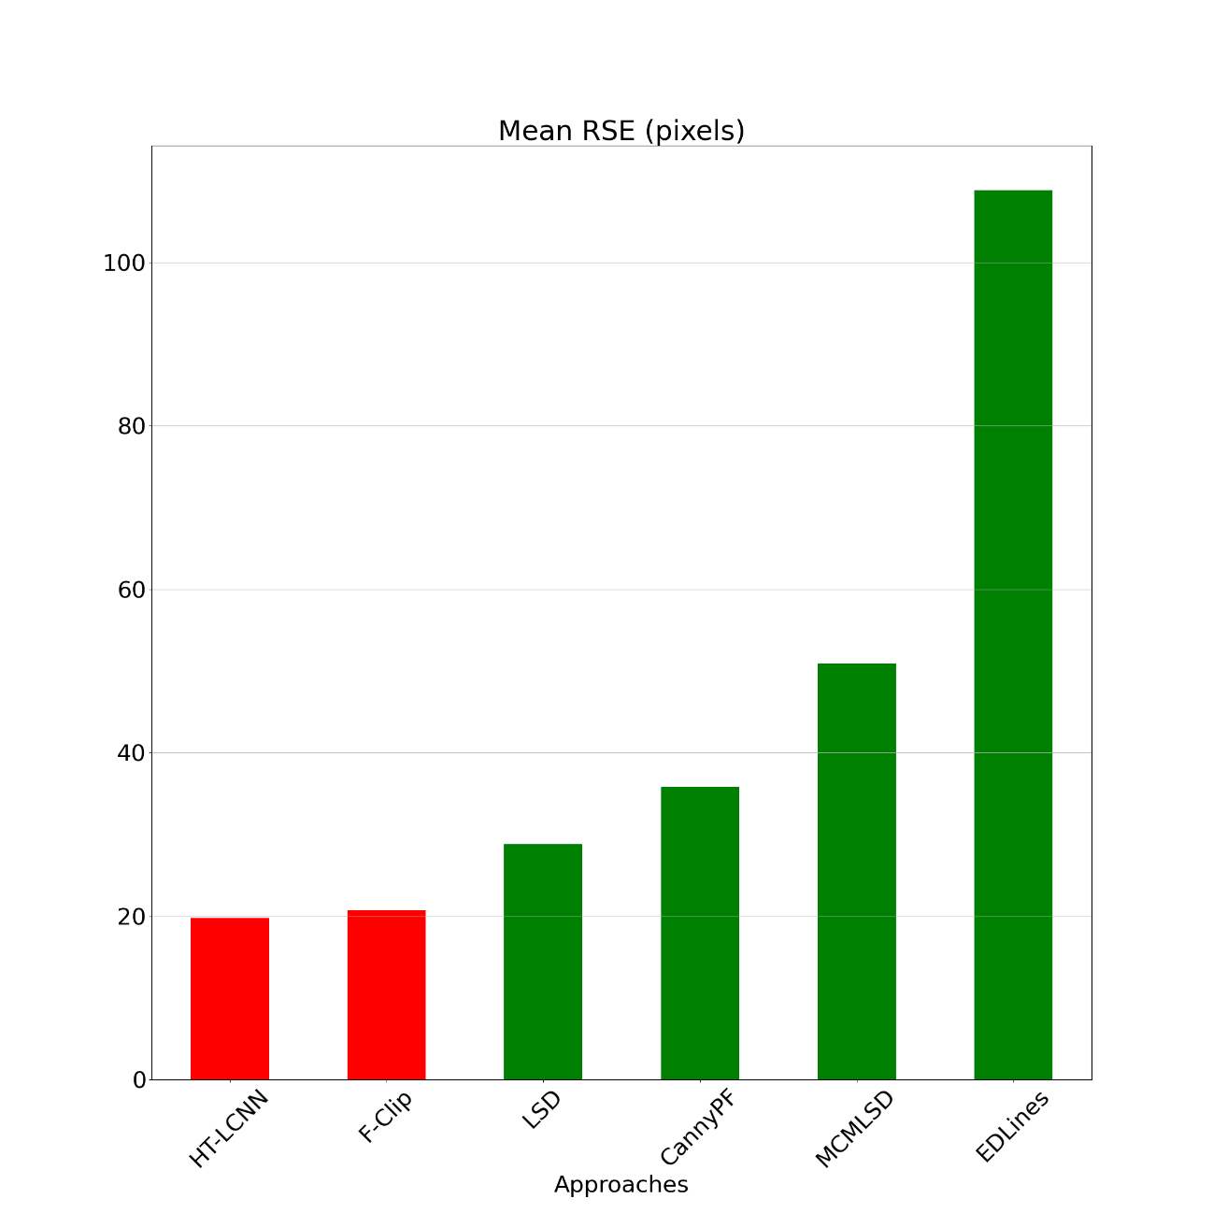
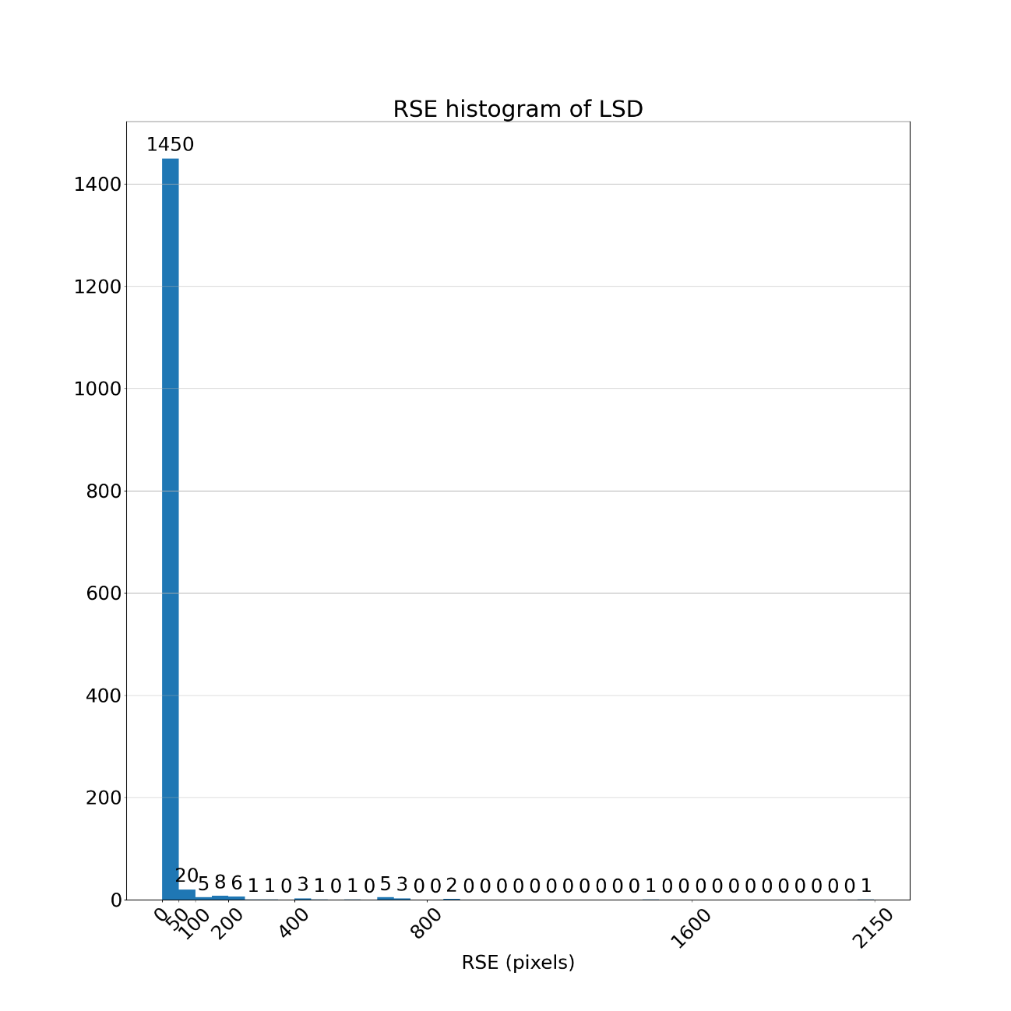
4.2 Evaluation: mean RSE (root square error)

Slide 24
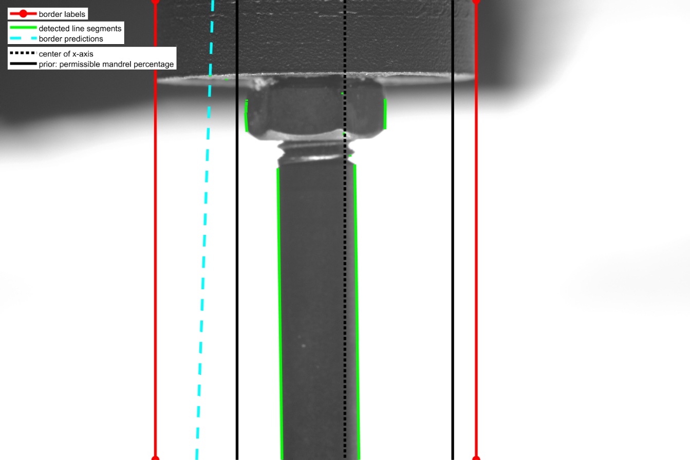
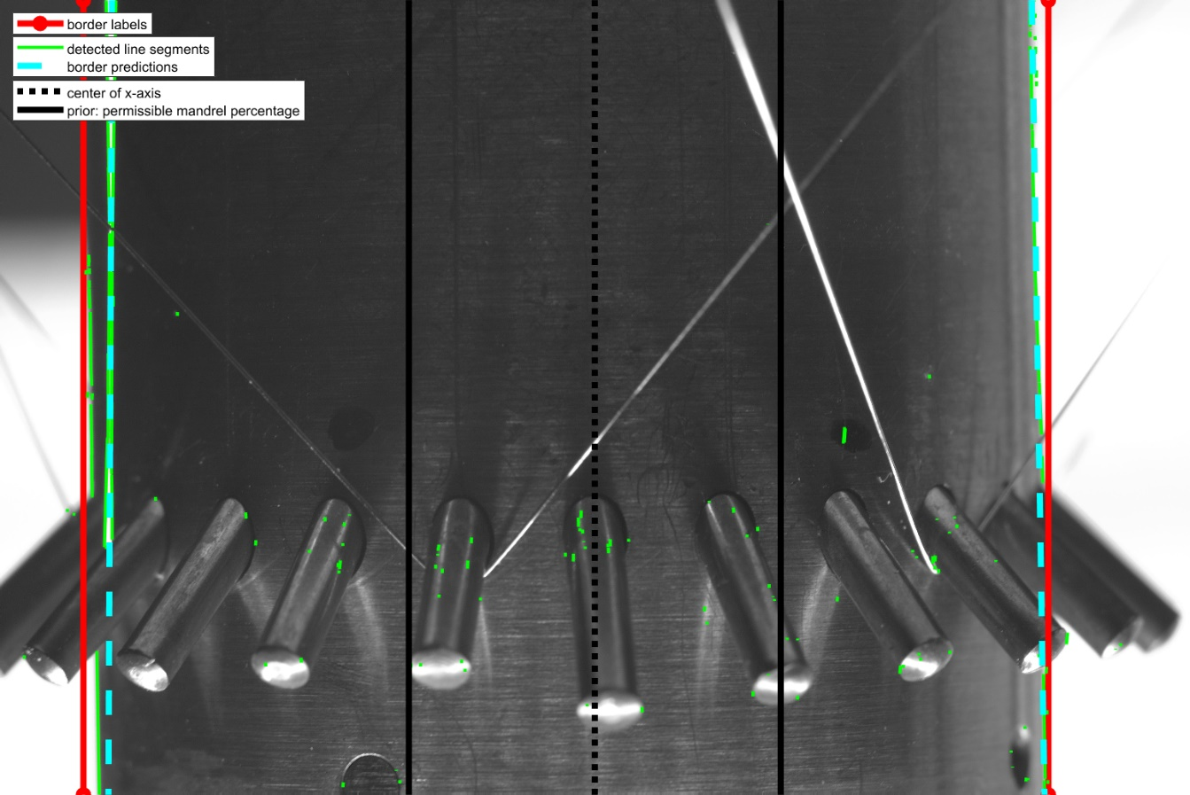

4.2 Evaluation: mean RSE (classic)
LSD: 2 kinds of bad cases
General in all classic approaches
Case 1: no edge detected around the borders
Case 2: noise (stent wire) around the left border

Slide 25
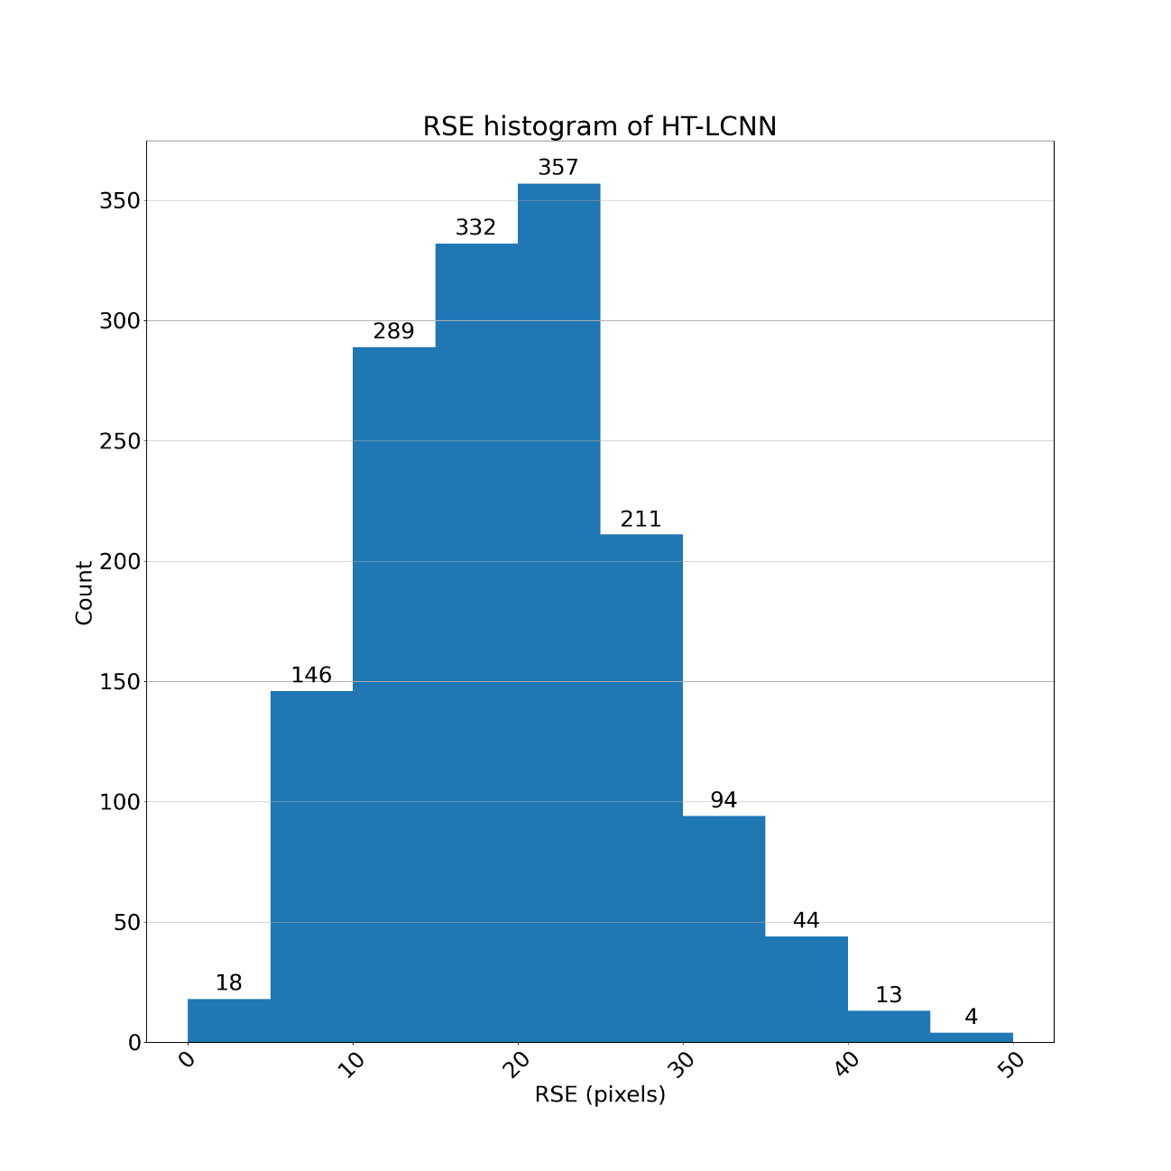
4.2 Evaluation: mean RSE (deep learning)

Slide 26
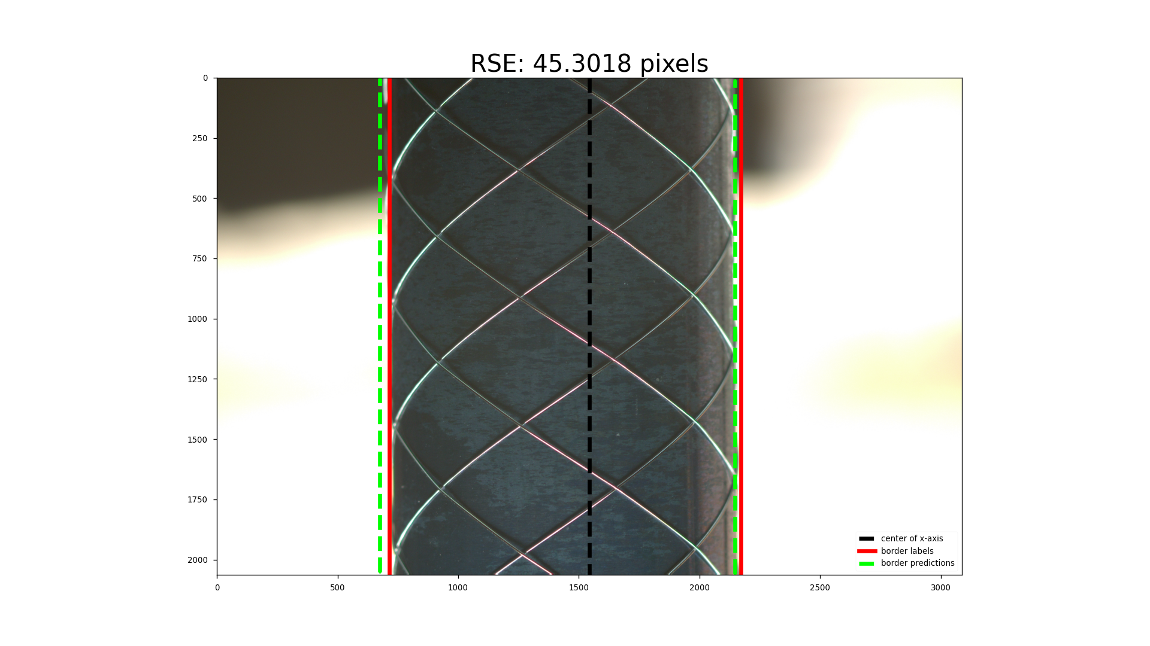
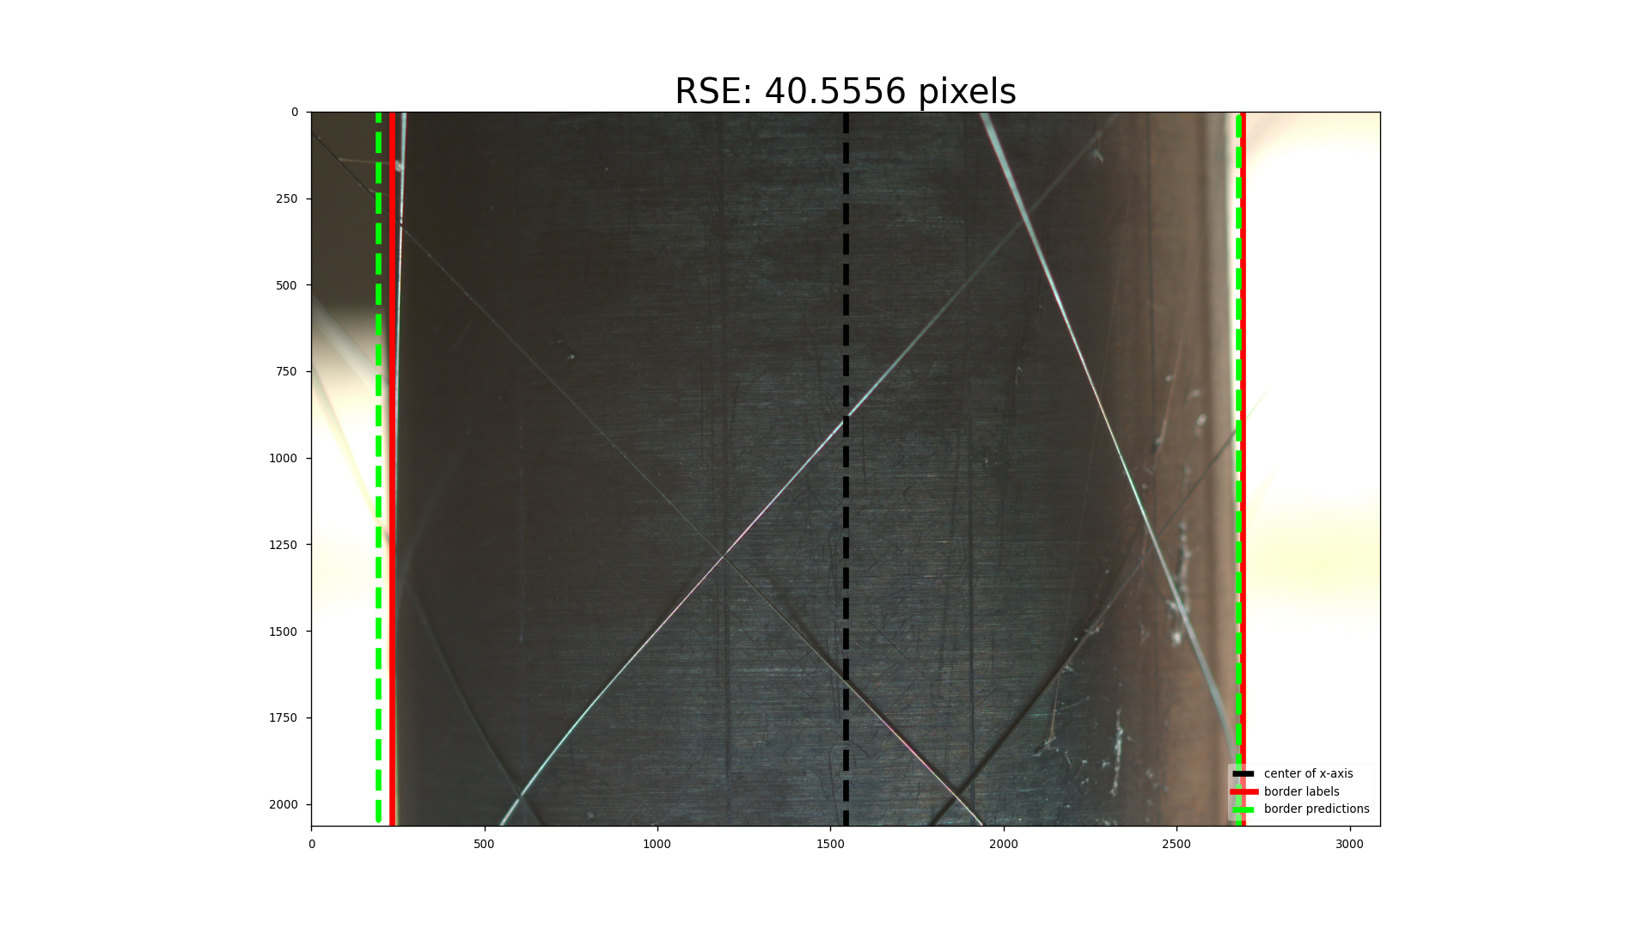
4.2 Evaluation metric: mean RSE
HT-LCNN: the predicted left border line in the left side of the labeled

Slide 27
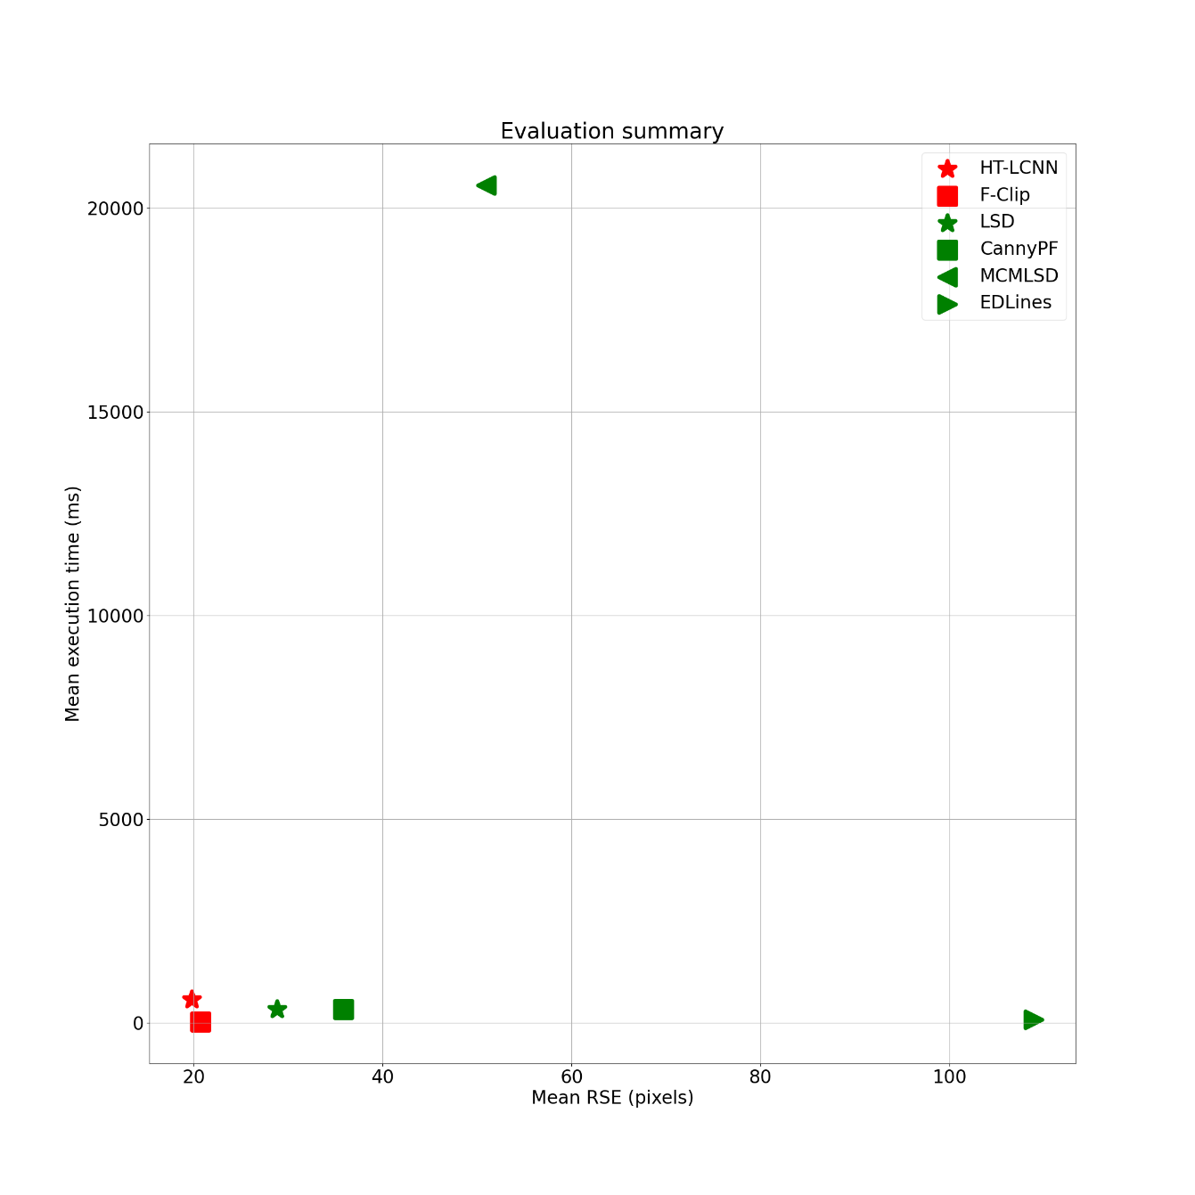
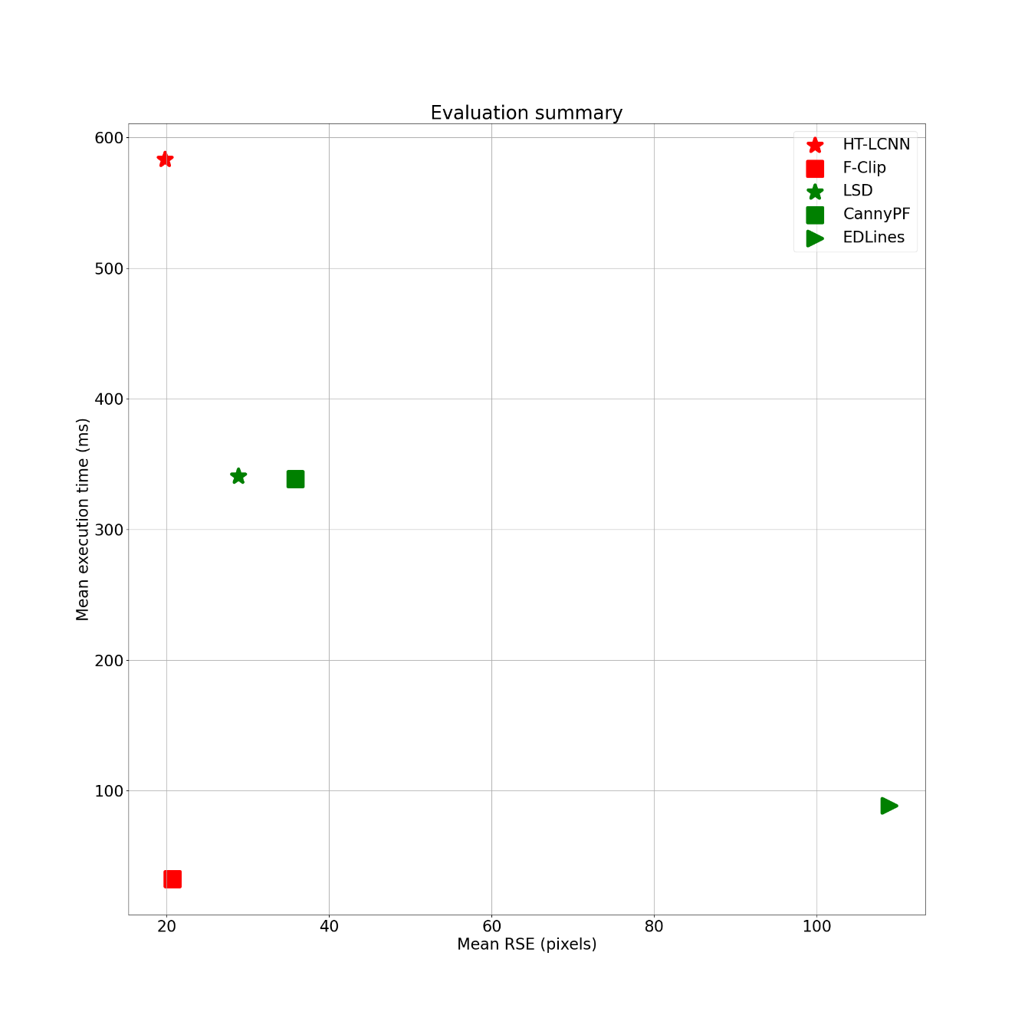
4.3 Evaluation summary
F-Clip

Slide 28
4.4 Extra: F-Clip
1 两张图：line -> 中心线
X轴的中心线
Label中心线
Pred中心线
说明文字：MAE

Slide 29
Structure
1 Motivation and Objective
2 Fundamental
3 Concept
4 Evaluation and Analyse
5 Conclusion and Outlook

Slide 30
5 Conclusion and outlook
Conclusion:
Implemented / reproduced 6 approaches
Metric mean RSE:
DL models show better performance: more robust to the noise
Lowest of all: HT-LCNN 19.77 pixels
Lowest of classic methods: LSD 28.8 pixels
Metric execution time: F-Clip is the fastest with 32 (ms / image)
Outlook:
Classic image process: based on LSD, deal with the two bad cases (robust to noise)
Deep learning: try to use two junctions to represent a border line instead of the vertical line
compared to the top point of the left border (obstruction from the background), easy to percept for human being

Slide 31
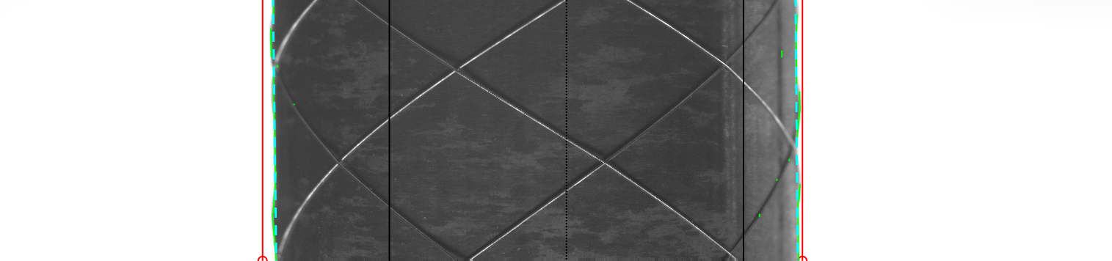
Thank you for your attention!
Start
Start
Load RGB image
Load RGB image
Edge detector
Backbone
Valid edge extractor
Head: multitask learner
Border line generator
Head: line prediction
Get border lines
Get border lines
End
End

Slide 32
Appendix - Reference
[1]

